Slide 1
Examples of continuous probability distributions:
The normal and standard normal

Slide 2
The Normal Distribution
f(X)
Changing μ shifts the distribution left or right.
Changing σ increases or decreases the spread.
σ
μ
X

Slide 3
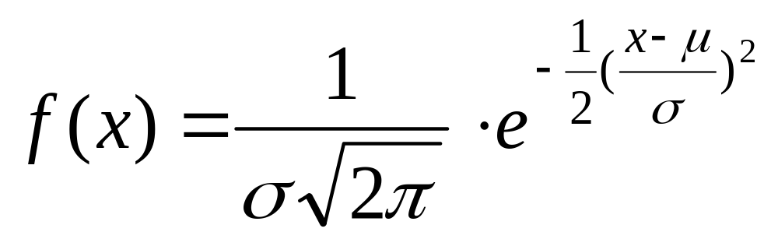
The Normal Distribution: as mathematical function (pdf)
This is a bell shaped curve with different centers and spreads depending on μ and σ
Note constants:
π=3.14159
e=2.71828

Slide 4
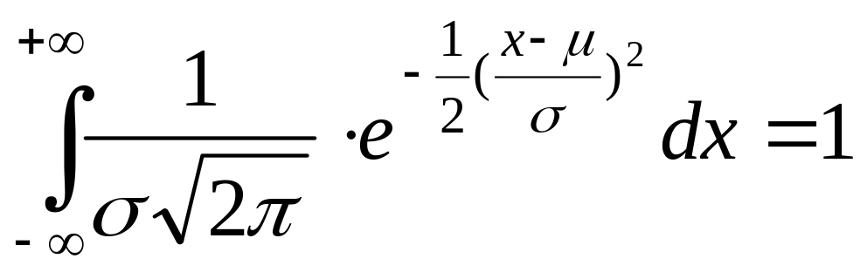
The Normal PDF
It’s a probability function, so no matter what the values of μ and σ, must integrate to 1!

Slide 5
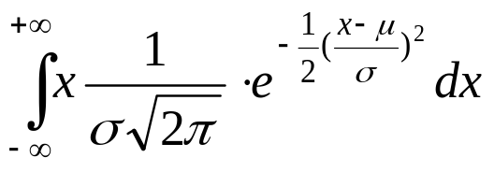
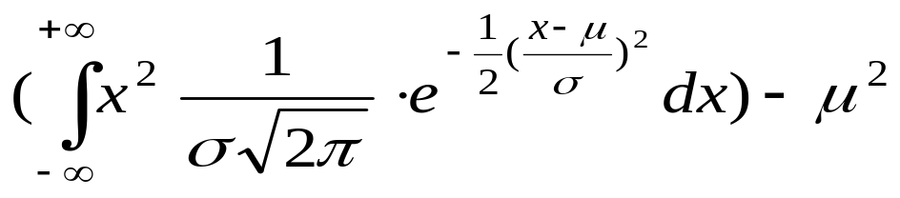
Normal distribution is defined by its mean and standard dev.
E(X)=μ =
Var(X)=σ² =
Standard Deviation(X)=σ

Slide 6
**The beauty of the normal curve:
No matter what μ and σ are, the area between μ-σ and μ+σ is about 68%; the area between μ-2σ and μ+2σ is about 95%; and the area between μ-3σ and μ+3σ is about 99.7%. Almost all values fall within 3 standard deviations.

Slide 7
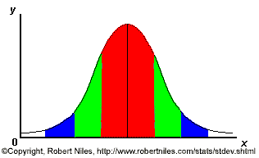
68-95-99.7 Rule
68% of the data
95% of the data
99.7% of the data
Notes:
SAY: within 1 standard deviation either way of the mean
within 2 standard deviations of the mean
within 3 standard deviations either way of the mean
WORKS FOR ALL NORMAL CURVES NO MATTER HOW SKINNY OR FAT

Slide 8
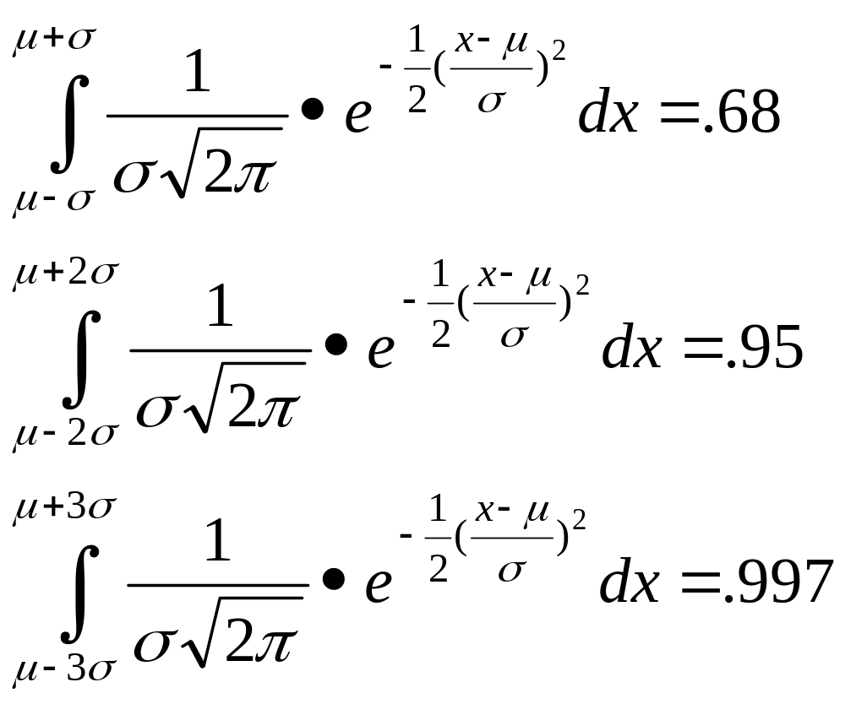
68-95-99.7 Rule in Math terms…

Slide 9
How good is rule for real data?
Check some example data:
The mean of the weight of the women = 127.8
The standard deviation (SD) = 15.5

Slide 10
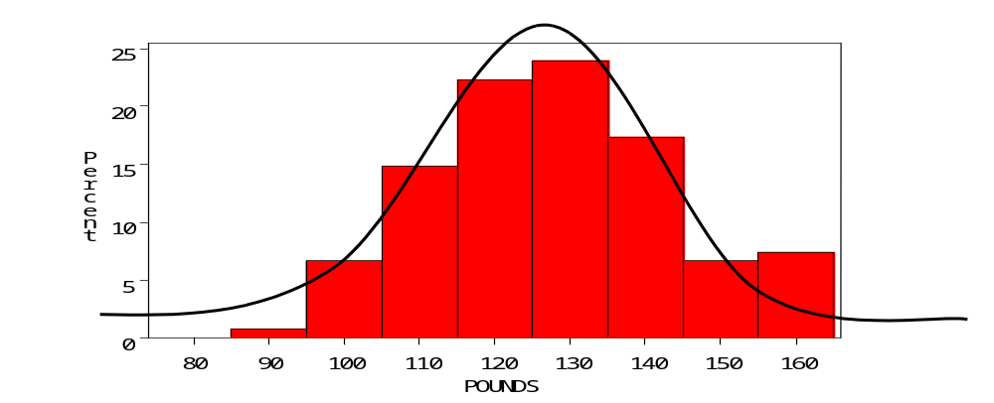
68% of 120 = .68x120 = ~ 82 runners
In fact, 79 runners fall within 1-SD (15.5 lbs) of the mean.
112.3
127.8
143.3

Slide 11
95% of 120 = .95 x 120 = ~ 114 runners
In fact, 115 runners fall within 2-SD’s of the mean.
96.8
127.8
158.8

Slide 12
99.7% of 120 = .997 x 120 = 119.6 runners
In fact, all 120 runners fall within 3-SD’s of the mean.
81.3
127.8
174.3

Slide 13
Example
Suppose SAT scores roughly follows a normal distribution in the U.S. population of college-bound students (with range restricted to 200-800), and the average math SAT is 500 with a standard deviation of 50, then:
  68% of students will have scores between 450 and 550
  95% will be between 400 and 600
  99.7% will be between 350 and 650

Slide 14
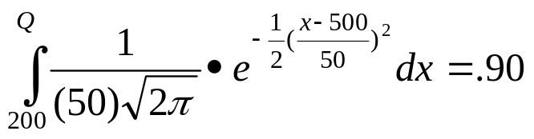
Example
BUT…
What if you wanted to know the math SAT score corresponding to the 90th percentile (=90% of students are lower)?
P(X≤Q) = .90 →
Solve for Q?….Yikes!

Slide 15
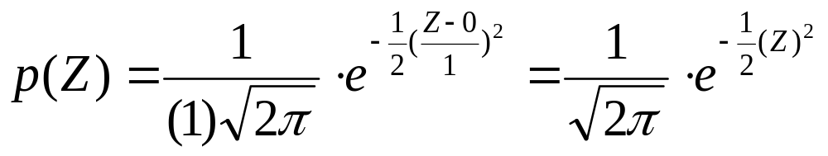
The Standard Normal (Z):
“Universal Currency”
The formula for the standardized normal probability density function is

Slide 16
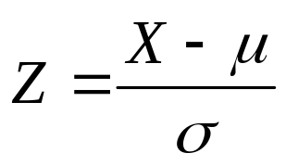
The Standard Normal Distribution (Z)
All normal distributions can be converted into the standard normal curve by subtracting the mean and dividing by the standard deviation:
Somebody calculated all the integrals for the standard normal and put them in a table! So we never have to integrate!
Even better, computers now do all the integration.

Slide 17
Comparing X and Z units
100
200
X
(μ = 100, σ = 50)
0
2.0
Z
(μ = 0, σ = 1)

Slide 18
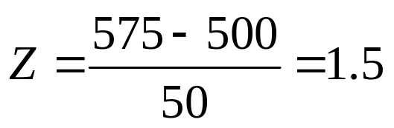
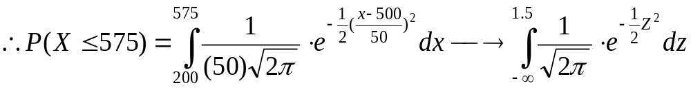
Example
For example: What’s the probability of getting a math SAT score of 575 or less, μ=500 and σ=50?
i.e., A score of 575 is 1.5 standard deviations above the mean
Yikes!
But to look up Z= 1.5 in standard normal chart (or enter into SAS)→ no problem! = .9332

Slide 19
Practice problem
If birth weights in a population are normally distributed with a mean of 109 oz and a standard deviation of 13 oz,
What is the chance of obtaining a birth weight of 141 oz or heavier when sampling birth records at random?
What is the chance of obtaining a birth weight of 120 or lighter?

Slide 20
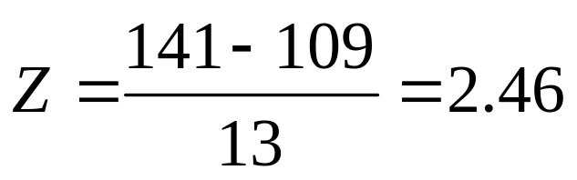
Answer
What is the chance of obtaining a birth weight of 141 oz or heavier when sampling birth records at random?
From the chart or SAS → Z of 2.46 corresponds to a right tail (greater than) area of: P(Z≥2.46) = 1-(.9931)= .0069 or .69 %

Slide 21
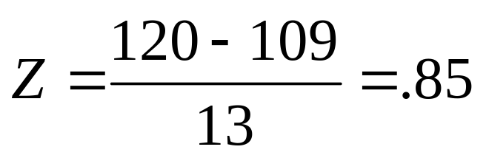
Answer
b. What is the chance of obtaining a birth weight of 120 or lighter?
From the chart or SAS → Z of .85 corresponds to a left tail area of:
P(Z≤.85) = .8023= 80.23%

Slide 22
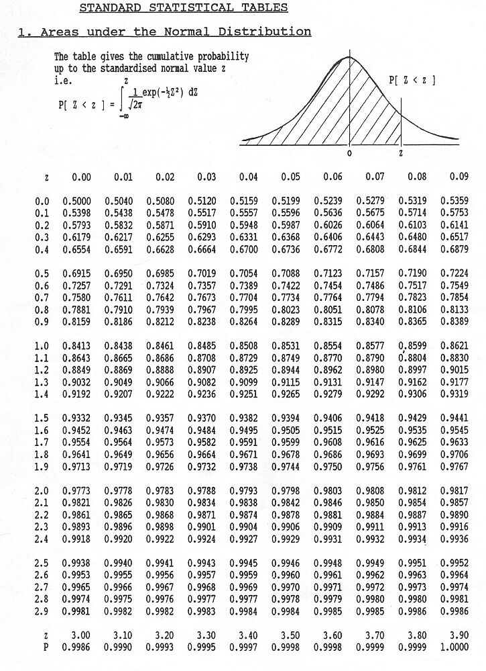
Looking up probabilities in the standard normal table
What is the area to the left of Z=1.51 in a standard normal curve?
Area is 93.45%
Z=1.51
Z=1.51

Slide 23
Normal probabilities in SAS
data _null_;
theArea=probnorm(1.5);
put theArea;
run;
0.9331927987
And if you wanted to go the other direction (i.e., from the area to the Z score (called the so-called “Probit” function→
data _null_;
theZValue=probit(.93);
put theZValue;
run;
1.4757910282
The “probnorm(Z)” function gives you the probability from negative infinity to Z (here 1.5) in a standard normal curve.
The “probit(p)” function gives you the Z-value that corresponds to a left-tail area of p (here .93) from a standard normal curve. The probit function is also known as the inverse standard normal function.

Slide 24
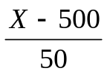
Probit function: the inverse
φ(area)= Z: gives the Z-value that goes with the probability you want
For example, recall SAT math scores example. What’s the score that corresponds to the 90th percentile?
In Table, find the Z-value that corresponds to area of .90 → Z= 1.28
Or use SAS
data _null_;
theZValue=probit(.90);
put theZValue;
run;
1.2815515655
If Z=1.28, convert back to raw SAT score →
1.28 =
X – 500 =1.28 (50)
X=1.28(50) + 500 = 564 (1.28 standard deviations above the mean!)
`

Slide 25
Are my data “normal”?
Not all continuous random variables are normally distributed!!
It is important to evaluate how well the data are approximated by a normal distribution

Slide 26
Are my data normally distributed?
Look at the histogram! Does it appear bell shaped?
Compute descriptive summary measures—are mean, median, and mode similar?
Do 2/3 of observations lie within 1 std dev of the mean? Do 95% of observations lie within 2 std dev of the mean?
Look at a normal probability plot—is it approximately linear?
Run tests of normality (such as Kolmogorov-Smirnov). But, be cautious, highly influenced by sample size!

Slide 27
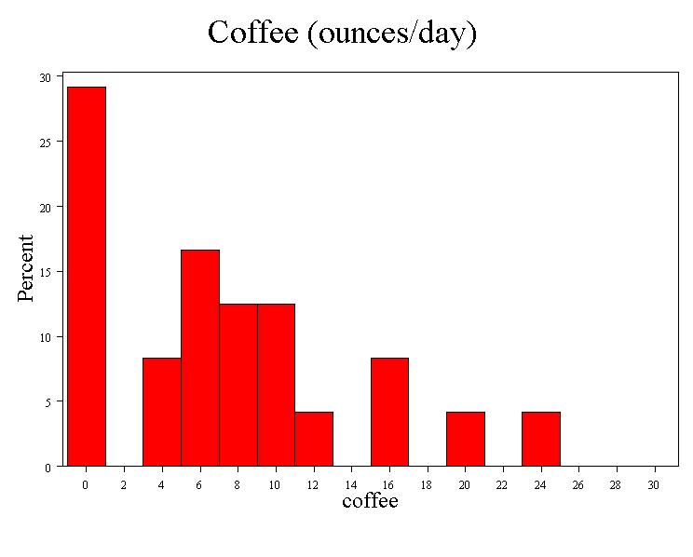
Data from our class…
Median = 6
Mean = 7.1
Mode = 0
SD = 6.8
Range = 0 to 24
(= 3.5 σ)

Slide 28
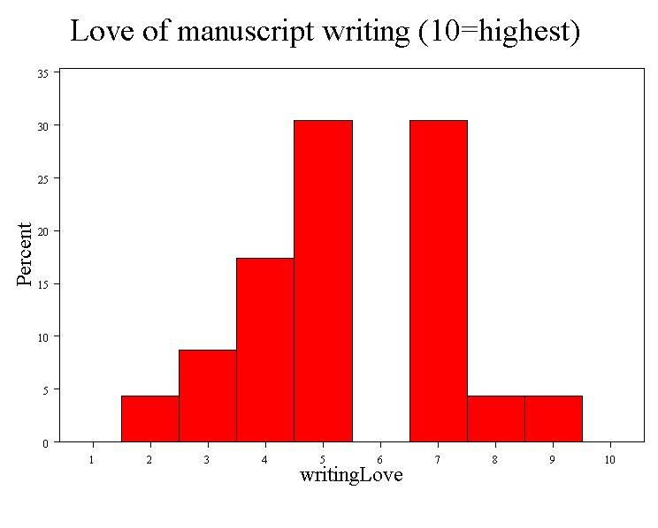
Data from our class…
Median = 5
Mean = 5.4
Mode = none
SD = 1.8
Range = 2 to 9
(~ 4 σ)

Slide 29
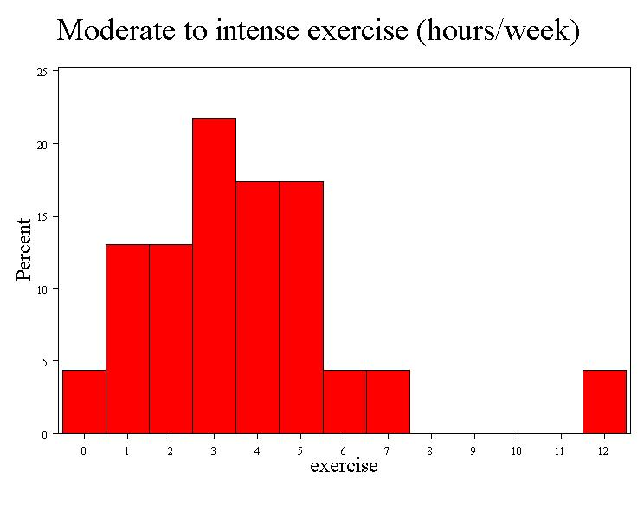
Data from our class…
Median = 3
Mean = 3.4
Mode = 3
SD = 2.5
Range = 0 to 12
(~ 5 σ)

Slide 30
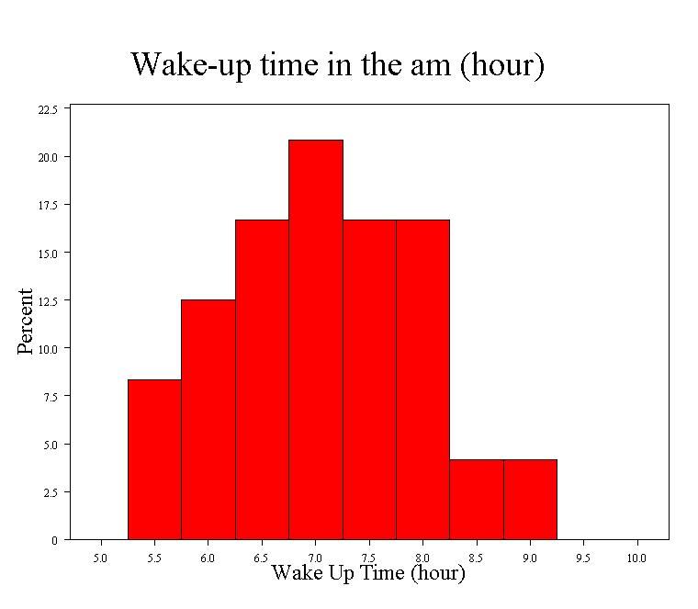
Data from our class…
Median = 7:00
Mean = 7:04
Mode = 7:00
SD = :55
Range = 5:30 to 9:00
(~4 σ)

Slide 31
Data from our class…
7.1 +/- 6.8 =
0.3 – 13.9
0.3
13.9

Slide 32
Data from our class…
7.1 +/- 2*6.8 =
0 – 20.7

Slide 33
Data from our class…
7.1 +/- 3*6.8 =
0 – 27.5

Slide 34
Data from our class…
5.4 +/- 1.8 =
3.6 – 7.2
3.6
7.2

Slide 35
Data from our class…
5.4 +/- 2*1.8 =
1.8 – 9.0
1.8
9.0

Slide 36
Data from our class…
5.4 +/- 3*1.8 =
0– 10
0
10

Slide 37
Data from our class…
0.9
5.9
3.4 +/- 2.5=
0.9 – 7.9

Slide 38
Data from our class…
0
8.4
3.4 +/- 2*2.5=
0 – 8.4

Slide 39
Data from our class…
0
10.9
3.4 +/- 3*2.5=
0 – 10.9

Slide 40
Data from our class…
6:09
7:59
7:04+/- 0:55 =
6:09 – 7:59

Slide 41
Data from our class…
5:14
8:54
7:04+/- 2*0:55 =
5:14 – 8:54

Slide 42
Data from our class…
4:19
9:49
7:04+/- 2*0:55 =
4:19 – 9:49

Slide 43
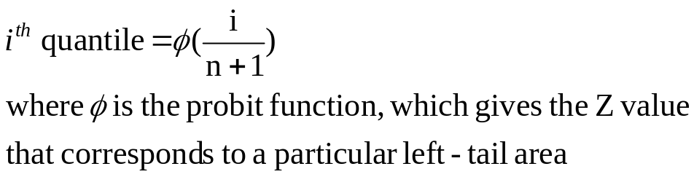
The Normal Probability Plot
Normal probability plot
  Order the data.
  Find corresponding standardized normal quantile values:
  Plot the observed data values against normal quantile values.
  Evaluate the plot for evidence of linearity.

Slide 44
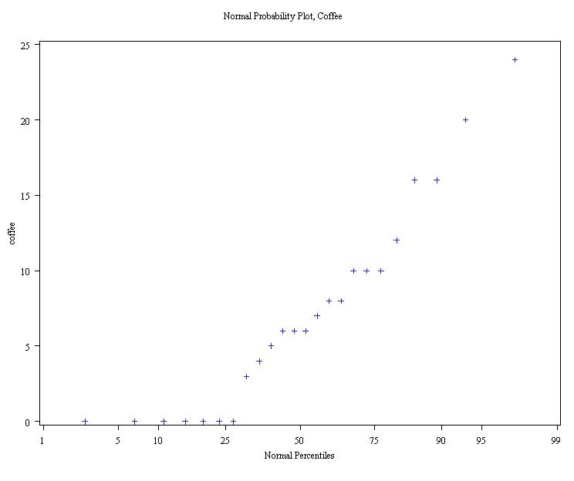
Normal probability plot coffee…
Right-Skewed!
(concave up)

Slide 45
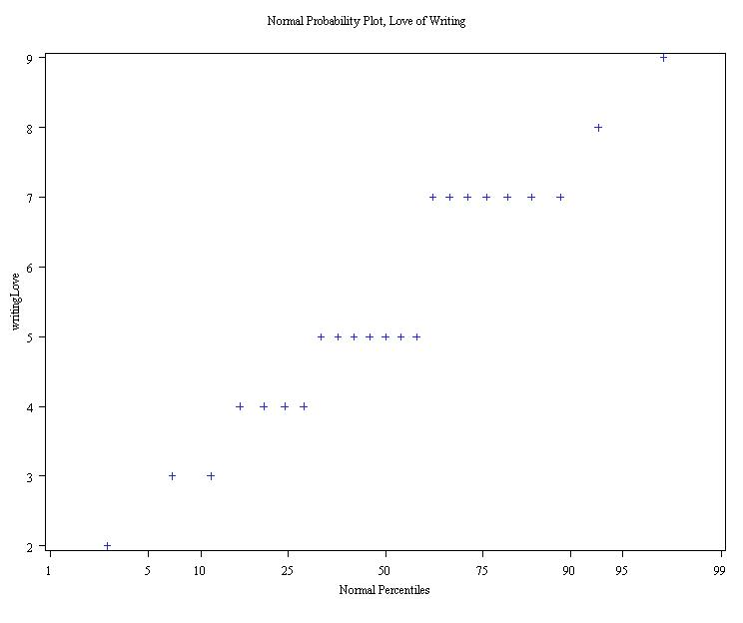
Normal probability plot love of writing…
Neither right-skewed or left-skewed, but big gap at 6.

Slide 46
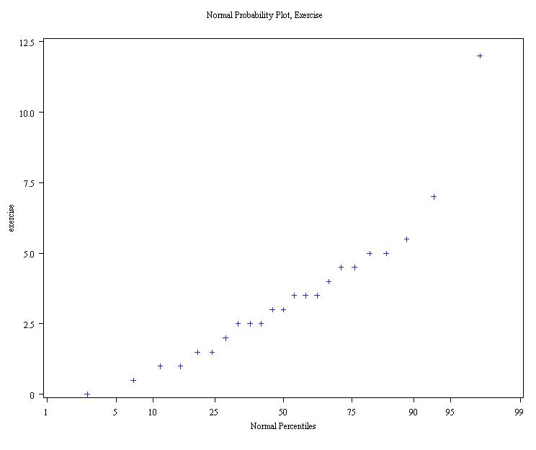
Norm prob. plot Exercise…
Right-Skewed!
(concave up)

Slide 47
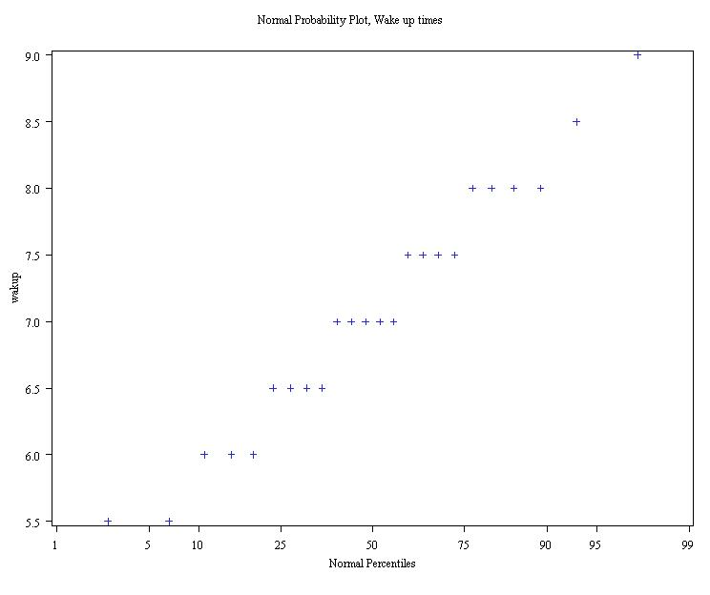
Norm prob. plot Wake up time
Closest to a straight line…

Slide 48
Formal tests for normality
Results:
Coffee: Strong evidence of non-normality (p<.01)
Writing love: Moderate evidence of non-normality (p=.01)
Exercise: Weak to no evidence of non-normality (p>.10)
Wakeup time: No evidence of non-normality (p>.25)

Slide 49
Normal approximation to the binomial
When you have a binomial distribution where n is large and p is middle-of-the road (not too small, not too big, closer to .5), then the binomial starts to look like a normal distribution→ in fact, this doesn’t even take a particularly large n→
Recall: What is the probability of being a smoker among a group of cases with lung cancer is .6, what’s the probability that in a group of 8 cases you have less than 2 smokers?

Slide 50
Normal approximation to the binomial
When you have a binomial distribution where n is large and p isn’t too small (rule of thumb: mean>5), then the binomial starts to look like a normal distribution→
Recall: smoking example…
.27
Starting to have a normal shape even with fairly small n. You can imagine that if n got larger, the bars would get thinner and thinner and this would look more and more like a continuous function, with a bell curve shape. Here np=4.8.
0
1
2
3
4
5
6
7
8

Slide 51
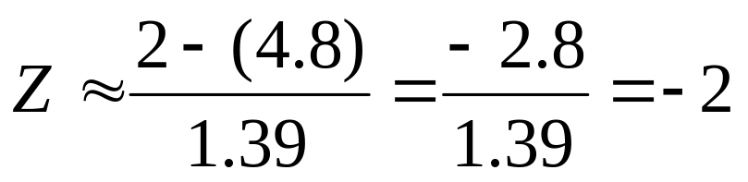
Normal approximation to binomial
.27
0
1
2
3
4
5
6
7
8
What is the probability of fewer than 2 smokers?
Exact binomial probability (from before) = .00065 + .008 = .00865
Normal approximation probability:
μ=4.8
σ=1.39
P(Z<2)=.022

Slide 52
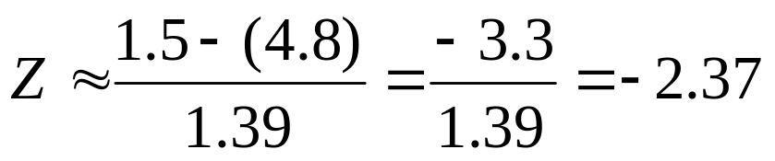
A little off, but in the right ballpark… we could also use the value to the left of 1.5 (as we really wanted to know less than but not including 2; called the “continuity correction”)…
A fairly good approximation of the exact probability, .00865.
P(Z≤-2.37) =.0069

Slide 53
Practice problem
1. You are performing a cohort study. If the probability of developing disease in the exposed group is .25 for the study duration, then if you sample (randomly) 500 exposed people, What’s the probability that at most 120 people develop the disease?

Slide 54




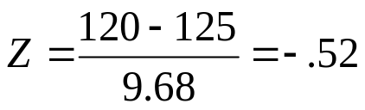
Answer
By hand (yikes!):
P(X≤120) = P(X=0) + P(X=1) + P(X=2) + P(X=3) + P(X=4)+….+ P(X=120)=
+
+
+
…
OR Use SAS:
data _null_;
Cohort=cdf('binomial', 120, .25, 500);
put Cohort;
run;
0.323504227
OR use, normal approximation:
μ=np=500(.25)=125 and σ²=np(1-p)=93.75; σ=9.68
P(Z<-.52)= .3015

Slide 55
Proportions…
The binomial distribution forms the basis of statistics for proportions.
A proportion is just a binomial count divided by n.
  For example, if we sample 200 cases and find 60 smokers, X=60 but the observed proportion=.30.
Statistics for proportions are similar to binomial counts, but differ by a factor of n.

Slide 56
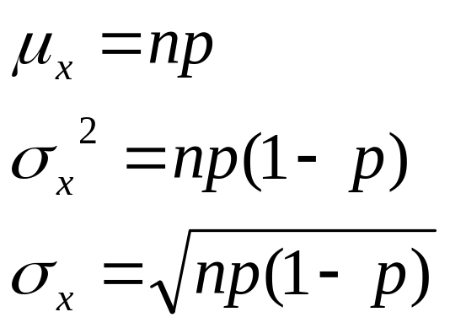
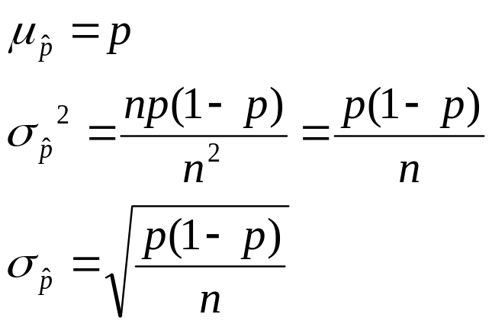
Stats for proportions
For binomial:
Differs by a factor of n.
Differs by a factor of n.
For proportion:
P-hat stands for “sample proportion.”

Slide 57
It all comes back to Z…
Statistics for proportions are based on a normal distribution, because the binomial can be approximated as normal if np>5

